Slide 1

Constructor and Destructor
Lecture 4

Slide 2
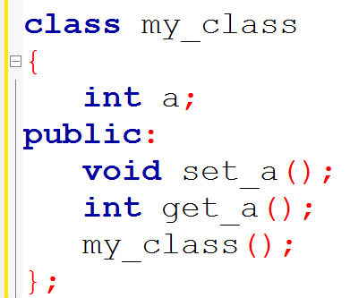
Constructor
Constructor

Slide 3
Constructor
Definition
A constructor function is a special member function that has the same name as the class of which it is a part and called(invoked) each time an object of that class is created.

Slide 4
Constructor
Member function of a class
Has same name as the class of which it is a part.
Has no return type.
Is called each time an object of that class is created.

Slide 5
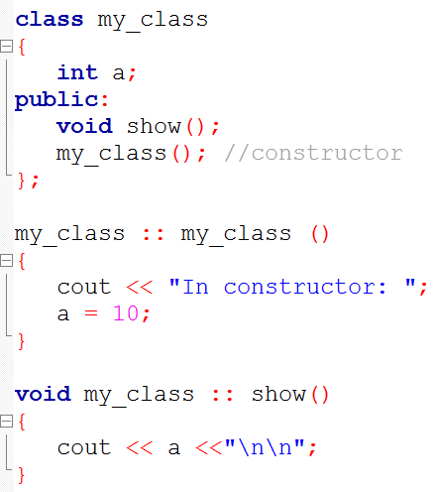
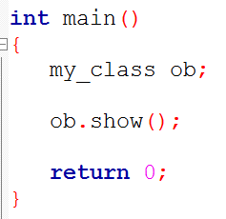
Constructor
No return type! According to C++ formal syntax rules, it is illegal for a constructor to have a return type.

Slide 6
Constructor

Slide 7
Constructor : Characteristics
Declared in the public section.
Invoked automatically when the objects are created.
Do not have return type.
Can have default arguments.
Cannot be virtual.
We cannot refer to their addresses.
They make ‘implicit calls’ to the operators ‘new’ and ‘delete’ when memory allocation is required.

Slide 8
Destructor
Definition
A destructor is a special member function of a class that is executed whenever an object of it's class goes out of scope or whenever the delete expression is applied to a pointer to the object of that class.

Slide 9
Destructor
The main use of destructors is to release dynamic allocated memory and perform cleanup.
Destructors are automatically called when an object is destroyed.
A destructor will have exact same name as the class prefixed with a tilde (~)
A destructor takes no arguments and has no return type.
Destructor can be very useful for releasing resources before coming out of the program like closing files, releasing memories etc.

Slide 10
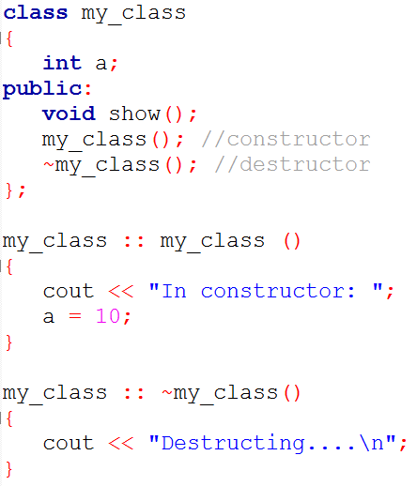
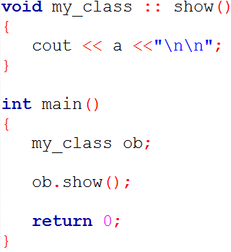
Destructor

Slide 11
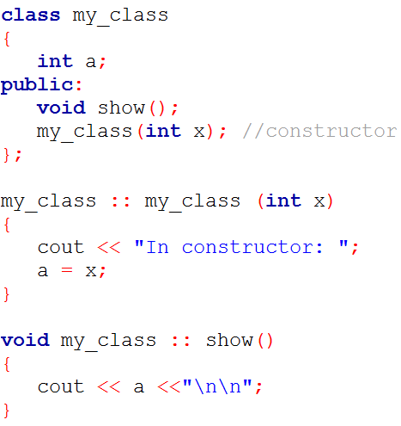
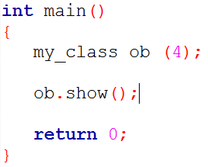
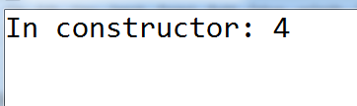
Parameterized Constructor

